Slide 1
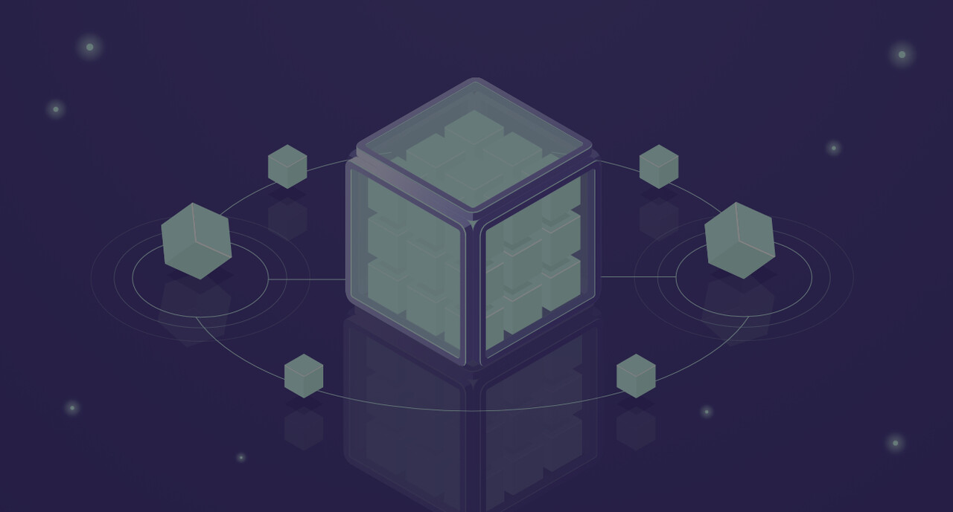
Bulkhead Pattern
SSDM Seminar
Anita Tehrani (S5843905@studenti.unige.it)

Slide 2
TABLE OF CONTENTS
Considerations
01
OVERVIEW
03
02
Scenarios
04
Advantages & Disadvantages
Bulkheads in Ships
Bulkhead Patterns
When this pattern should and shouldn’t be implemented?

Slide 3
01
SECTION
What are Bulkhead Patterns?

Slide 4


INTRODUCTION
Where does Bulkhead’s name come from?
Bulkheads are strong walls
Ship stays safe, Balanced, afloat,
challenges on the journey

Slide 5
02
SECTION
Scenarios

Slide 6
Scenario 1:
Service 1
Service 3
Bulkhead Pattern
Service 2
limit the scope of failure
one failure should not cause the entire system to fail
Service 1
Service 3
Pool 1
Service 2
Service 3
Pool 2

Slide 7
Scenario 2:
Normal Situation
Package Request
Mobile Service
Package Service
Transfer Request
Transfer Service
Available Threads

Slide 8
Scenario 2:
Failure Situation
Package Request
Mobile Service
Package Service
Package Service
Transfer Request
Transfer Service
Available Threads

Slide 9
Scenario 2:
Normal Situation
(with bulkhead design pattern)
Package Request
Mobile Service
Package Service
Transfer Request
Transfer Service
Package
Service
Transfer
Service
Available Threads

Slide 10
Scenario 2:
Failure Situation
(with bulkhead design pattern)
Package Request
Mobile Service
Package Service
Package Service
Transfer Request
Transfer Service
Package
Service
Transfer
Service
Available Threads

Slide 11
Scenario 3:
Service C
Service C
Service B
Service B
Service A
Service A

Slide 12
Scenario 3:
Service C
Service B Connection Pool
Service B
Service A Connection Pool
Service A Connection Pool
Service A
Service A

Slide 13
Scenario 3:
Service C
Service B Connection Pool
Service B
Service A Connection Pool
Service A
10K Requests
Container
Container
10M Requests

Slide 14
Scenario 3:
Service C
Service B Connection Pool
Service B
Service A Connection Pool
Service A
Container
10K Requests
Container
10M Requests

Slide 15
Scenario 3:
Service C
Service B Connection Pool
Service B
Service A Connection Pool
Service A
Container
Container
Container
10M Requests
10K Requests
Attack

Slide 16
Scenario 4:
Service X
Service X
1M requests
20K requests
15K requests
17K requests

Slide 17
Scenario 4:
Service X
1M requests
Container
Container
20K requests
15K requests
Container
17K requests
Container

Slide 18
Scenario 4:
Service X
Container
1M requests
Container
20K requests
15K requests
Container
17K requests
Container

Slide 19
Scenario 4:
Service X
Container
1M requests
Container
20K requests
15K requests
Container
Attack
Container

Slide 20
03
SECTION
Considerations
When this pattern should and shouldn’t be implemented?

Slide 21
Considerations
Level of isolation
Combine with other patterns

Slide 22
Scenario 3:
Service C
Service B
Service A
Service A

Slide 23
Considerations
Level of isolation
Improved fault tolerance
Consider processes and threads pools
Deploying into separate containers, or processes
Asynchronous communication

Slide 24
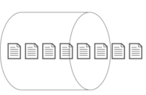
Service C
Service B
Service A
Service A
Queue

Slide 25
Considerations
Level of isolation
Improved fault tolerance
Consider processes and threads pools
Deploying into separate containers, or processes
Asynchronous communication
Monitoring

Slide 26
When to use bulkhead pattern?
Isolate critical consumers from standard consumers
Protect the application from cascading failure
Isolate resources used to consume backend services

Slide 27
When not to use bulkhead pattern?
Less efficient use of resources
The added complexity is not necessary

Slide 28
04
SECTION
Advantages & Disadvantages

Slide 29



Advantages of Bulkheads Pattern
Isolation of failures
Improved fault tolerance
Optimized Space Utilization

Slide 30




Disadvantages of Bulkheads Pattern
Changing Environments
Increased Construction Complexity
Design Challenges
Potential Cost Implications

Slide 31
THANKS!
Do you have any questions?

Slide 32
RESOURCES
https://ctrlshift.dev
https://stackoverflow.com
https://www.vinsguru.com
https://mehmetfiratkomurcu.hashnode.dev
https://medium.com
https://learn.microsoft.com/
https://dzone.com
Youtube videos

